Slide 1
An introduction to writing code for humans
A clean code primer
Notes:
Advanced warning of expletives
‹#›

Slide 2
Introduction
Email: s.p.tippett@gmail.com
Currently working on windows apps
Always have time to discuss clean code and agile development

Slide 3

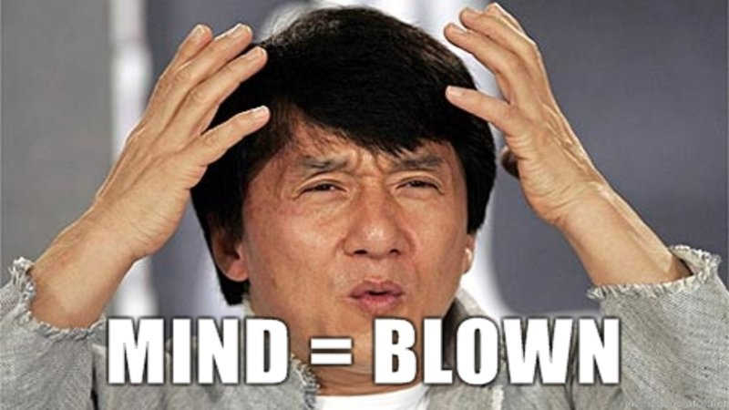
Think about it
All code is technical debt
Notes:
Code is complex, the more of it you write the more of it you have to maintain. Maintaining code takes time, and time is money, money which we have to pay in future; therefore all code is tech debt
‹#›

Slide 4
Why write cleaner code?

Slide 5
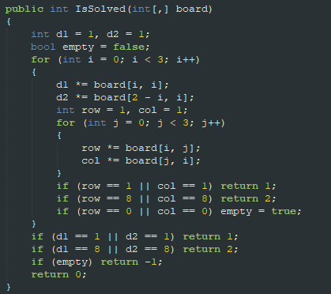
What does this do?
Notes:
Give 30 seconds to examine code
‹#›

Slide 6
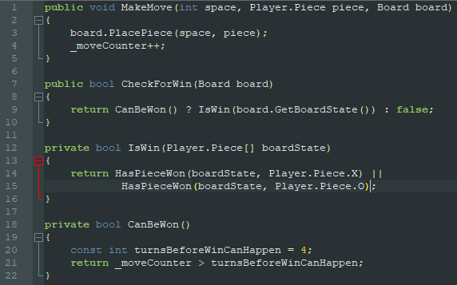
It does the same as this
Notes:
This isn’t the best it could be, but it’s a whole lot more descriptive of what it’s doing than the previous one. We can tell it’s a game, or at least something that you can win, there's also a board, so that helps us narrow it down. There are pieces to be positioned on a board, and the pieces are ‘O’ and ‘X’; or “Noughts” and “Crosses”
We can also tell that it’s impossible to win the game before turn 5
‹#›

Slide 7
Let’s digest
Notes:
So, the left is an example of bad code, the right an example of clean(er) code
Lets think about how we can make the code on the left cleaner.
‹#›

Slide 8
WTF are magic variables anyway?
We’ve got 3 right here

Slide 9

WTF are magic variables anyway?

Slide 10

FFS use words
Figured it out yet?

Slide 11
FFS use words
d1 and d2 are diagonal1 and diagonal2, whatever that means

Slide 12
IF
IF
IF
IF
IF
IF
IF
IF
IF
IF
IF
IF
IF
IF
IF
High noise to signal wastes cognitive resource

Slide 13
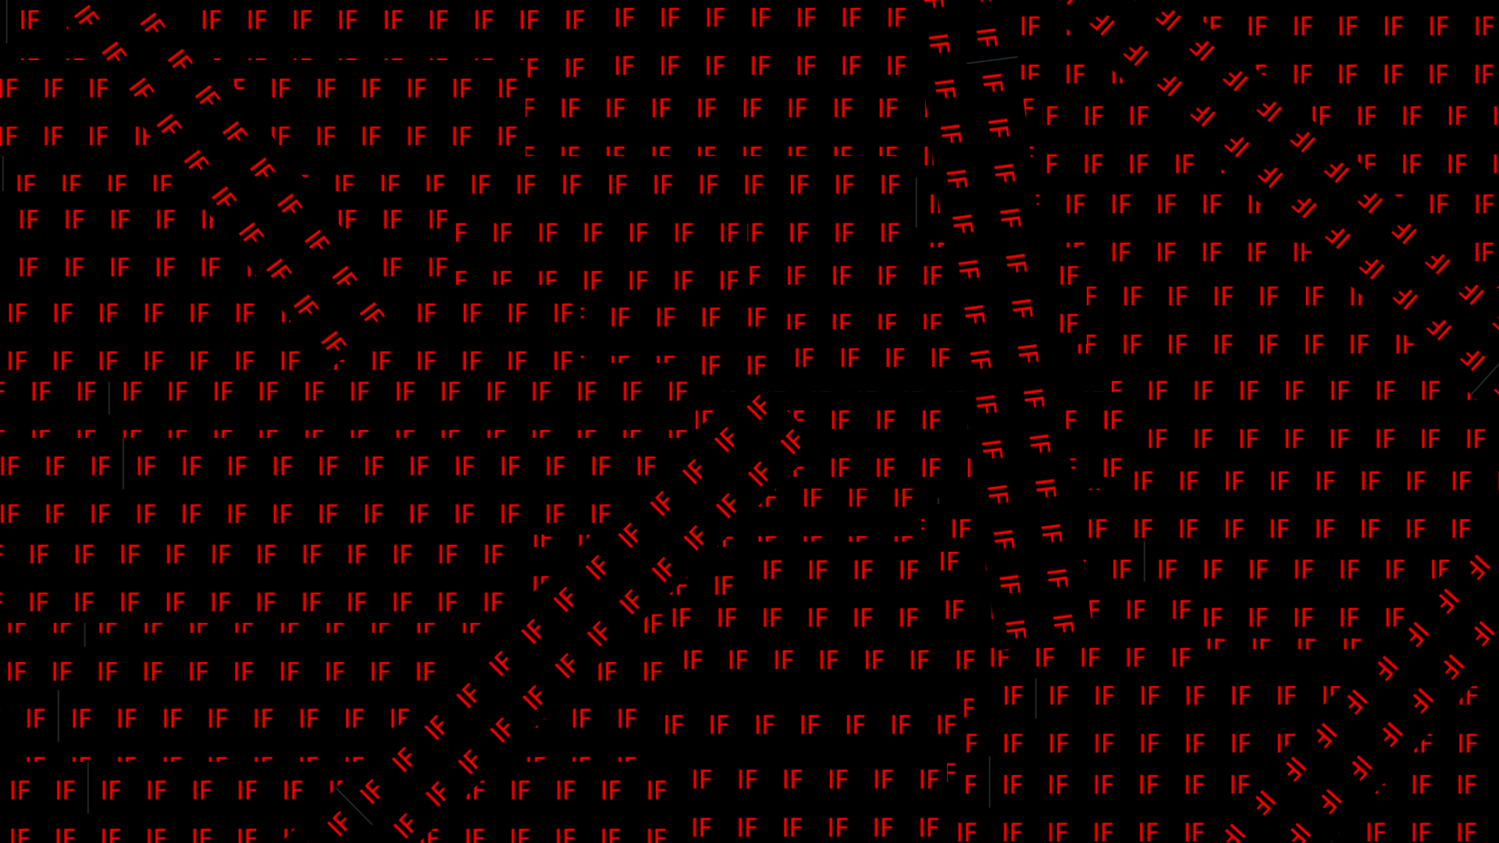

Slide 14
Your if’s are always describing something. So just call it what it is

Slide 15
High noise to signal wastes cognitive resource

Slide 16
What’s the most dangerous code in source control?

Slide 17
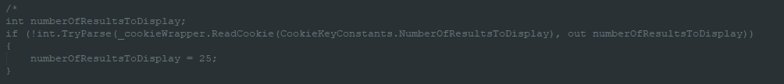
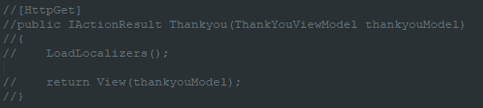
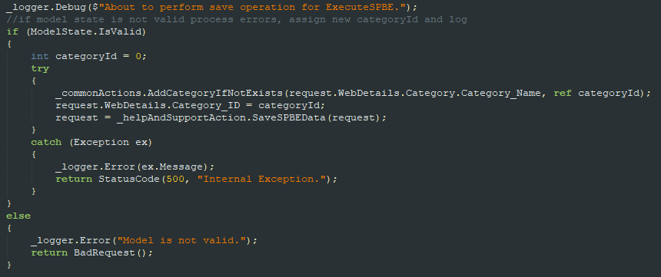
Commented out code should never be in source control.

Slide 18
The same goes for unused code
For the love of god; don’t future-gaze
If you write something that you don’t need, remove it

Slide 19


Death by a thousand
Line helper classes…
Logging in helps the user make an order…. Better put that logic in the UserHelper class

Slide 20
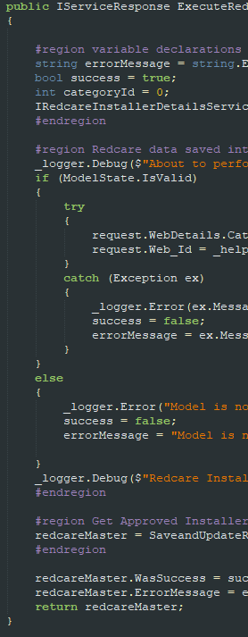
What’s worse than seeing regions separating methods?
Notes:
‹#›

Slide 21
Closing
Like anything it takes time
Lead by example
Create a coding standards charter for you and your team to hold each other accountable to

Slide 22
Questions?

